Slide 1
What is AP* Computer Science A?
Acetlinx

Slide 2
What is an AP Exam?
Exams offered by the College Board
Offer exams in a variety of subjects
Equivalent to a college class
If you pass, there is potential to get college credit.

Slide 3
AP Grading
5 - Highly Qualified
4 - Pretty Qualified
3 - Qualified
2 - Maybe Qualified
1 - No Recommendation

Slide 4
What is AP Computer Science A?
College-Level Programming Class
Object - Oriented Programming
Algorithm Development
Abstraction
Java Programming Language
Computational Thinking

Slide 5
Exam Details
Two Sections
40 Multiple Choice Questions
1 hour & 15 minutes
4 Free Response Questions
1 hour and 45 minutes

Slide 6
Multiple Choice Section
No guessing penalty
Encouraged to answer every question
Don’t waste your time
Scantron graded
Erase properly
Bubble in correctly

Slide 7
Free Response Questions
9 points per FRQ
Partial credit is given
AP Java Subset
Comments don’t give extra points
Human graded section

Slide 8
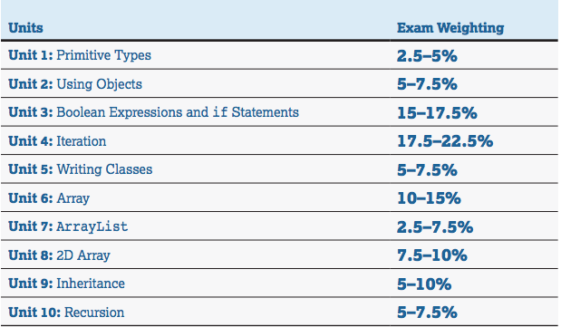
Source: The College Board

Slide 9
Necessary Materials
A working computer
An Integrated Development Environment (IDE)
A determined mindset

Slide 10
Resources to Help
The College Board
Barron’s AP Computer Science A
Albert.io

Slide 11
Why Should You Take this Course?
Introductory programming class
Many career paths
Many basic items need programming
Advances critical thinking
Technology is the future

